Slide 1
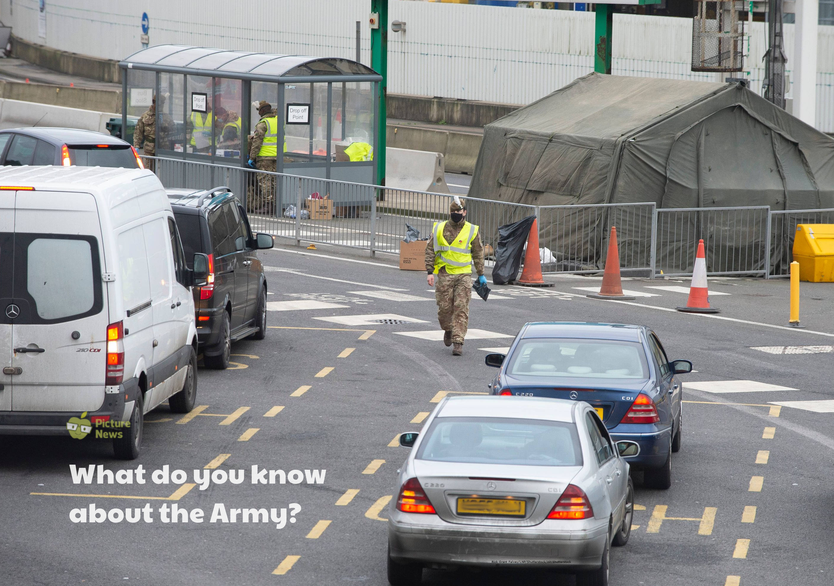

Slide 2
What is happening in the news this week?
The Army is helping out with the coronavirus pandemic. In the poster, they are helping to give coronavirus tests to people who are wanting to travel to France.
Why do you think the Army are helping out with this?

Slide 3
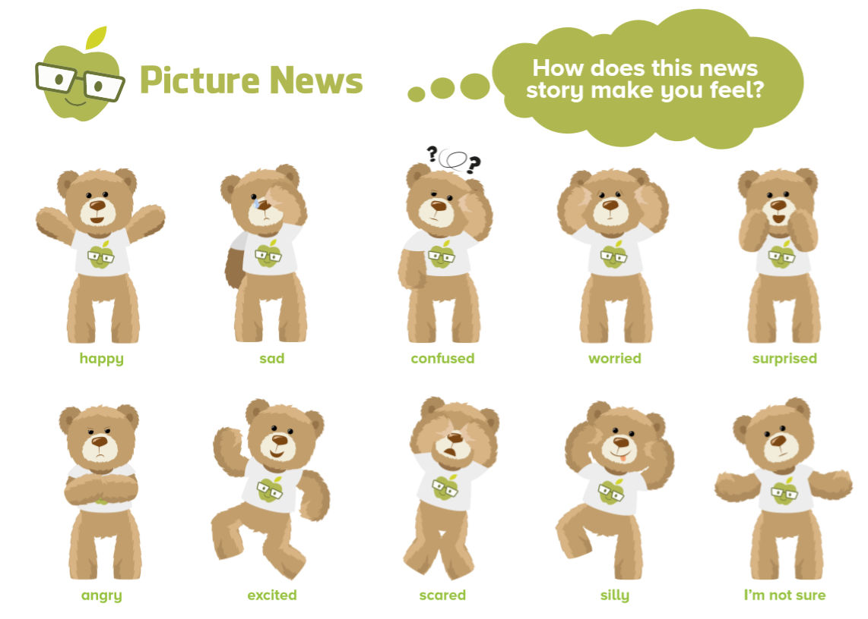

Slide 4
What new words have we learnt that we haven’t heard before?
Write a list:

Slide 7
Have a go at this week’s writing challenge!

